Slide 1
CD8 T Cell Fates
& Tumor Immunotherapy
Effectors · Memory · Exhaustion · CD4 Help · Checkpoint Immunotherapy
Killer Effector
Memory Cell
Exhausted Cell
Notes:
”Hello, I’m Om and today I’ll cover what happens to a CD8 T cell after it sees an antigen for the first time?”
EXPLANATION FOR UNDERSTANDING
This presentation answers a four-part immunology question:
(a) What are the three fates? (b) What conditions bias them? (c) What role does CD4 help play? (d) Why do lower-affinity T cells form memory?
The three fate pills on the slide — Killer Effector, Memory Cell, Exhausted Cell — each represent a distinct differentiation state with its own transcriptional programme, epigenetic signature, and functional outcome. Keep these three categories in mind as you go through each slide.

Slide 2
Three CD8 T Cell Fates: Overview
Killer Effector
Memory Cell
Exhausted Cell
Immediate cytotoxic function — kills within hours
Deploys Granzyme B, Perforin, TRAIL
Secretes IFN-γ, TNF-α at high levels
Expresses T-bet hi / Eomes lo
Short-lived: undergoes clonal contraction
~90% die by day 7–10 post-infection
Cannot self-renew; no homeostatic proliferation
Long-lived: persists for years/decades
Expresses IL-7Rα (CD127) for survival
High TCF-1 (Tcf7) for self-renewal
Eomes hi, Bcl-2 hi (anti-apoptotic)
Central (Tcm: lymph nodes) & Effector (Tem: tissue) subtypes
Rapid recall on re-challenge (24–48 hrs)
Maintained by homeostatic IL-7/IL-15 signaling
Progressive loss of function over time
Hierarchical loss: IL-2 first → TNF → IFN-γ → CTL
Co-inhibitory receptors: PD-1, TIM-3, LAG-3, TIGIT
TOX transcription factor drives epigenetic lock
Progenitor (TCF-1+ PD-1lo) → Terminal (TIM-3+ TOXhi)
Metabolic dysfunction: impaired OXPHOS & glycolysis
Partially reinvigorated by anti-PD-1 therapy
Notes:
So CD8 T Cells or cytotoxic T lymphocytes immune cells who find and kill infected or abnormal cells in your body. When a CD8 T cell encounters antigen for the first time, it enters a differentiation process that transforms it to one of three types of cells.
The Killer Effector is the immediate response, so it proliferates a bunch, kills target cells using cytotoxic molecules (so Granzyme B and Perforin), and secretes high levels of cytokenes IFN-gamma and TNF-alpha. But this cell is designed to be temporary: after antigen is cleared, about 90% die by day 7–10 through apoptosis.
The Memory Cell is like long term defense so It expresses IL-7 receptor alpha so it can receive homeostasis-based survival signals, and it can also last for decades as it uses Bcl-2 to resist apoptosis which binds to and neutralizes Bim and Bax at the mitochondria. Memory cells also split into central memory cells in lymph nodes and effector memory cells which stay in the surrounding tissues.
The Exhausted Cell is the problem in cancer and is what happens under severe antigen stimulation. There’s a progressive loss of function, first IL-2, then TNF-alpha, then we also see the continuous build up of co-inhibitory receptors which is locked into this building up state by a transcription factor called TOX. The receptors produced negatively regulate T-cell activation.
There are also two sub-states: progenitor exhausted cells that still respond to therapy, and terminal exhausted cells that don’t.
EXPLANATION FOR UNDERSTANDING
Key distinction: exhaustion is NOT simply strong activation — it is a distinct cell fate with its own transcriptional programme driven by TOX and NR4A factors.
Hierarchy of function loss in exhaustion: IL-2 → TNF-alpha → IFN-gamma → cytolysis. This order matters for assessing dysfunction severity.
Interconversion rules: Effectors cannot revert to memory. Terminal Tex cannot be rescued. Only progenitor Tex (TCF-1+ PD-1lo) responds meaningfully to anti-PD-1 checkpoint blockade — this is why knowing the ratio of progenitor to terminal Tex predicts therapy outcome.

Slide 3
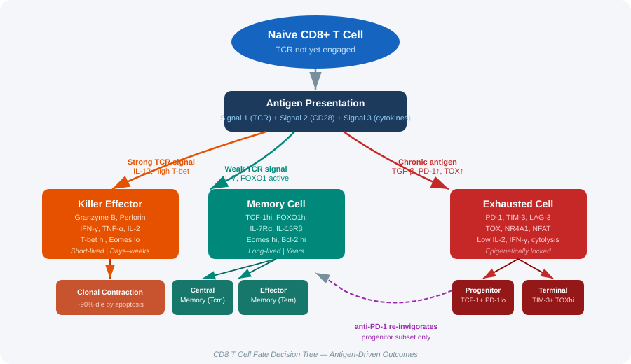
CD8 T Cell Fate Decision Tree
Notes:
On this slide I put together a cool decision tree visual that tracks a CD8 T cell to each of the three different fates.
At the top a naive cell encounters an antigen. The strength and nature of that encounter — TCR signal, co-stimulation, cytokine context — determine which branch it takes.
Strong TCR signals with IL-12 push toward the killer effector branch.
A weaker TCR signal with IL-7 signalling push toward memory.
And then Chronic, persistent antigen — what happens in a tumour — pushes toward exhaustion because of the TOX transcription factor.
EXPLANATION FOR UNDERSTANDING
The branching happens early — memory precursor effector cells (MPECs) are identifiable as early as the first cell division.
Key transcription factors at each branch:
- Effector branch: T-bet (high), Eomes (low), mTOR active
- Memory branch: TCF-1 (high), FOXO1 active, Eomes (high later)
- Exhaustion branch: TOX (high), NR4A1/2/3, NFAT without AP-1
The Tcm/Tem distinction within memory is important: central memory (CCR7+) homes to lymph nodes, effector memory (CCR7-) patrols peripheral tissues.

Slide 4
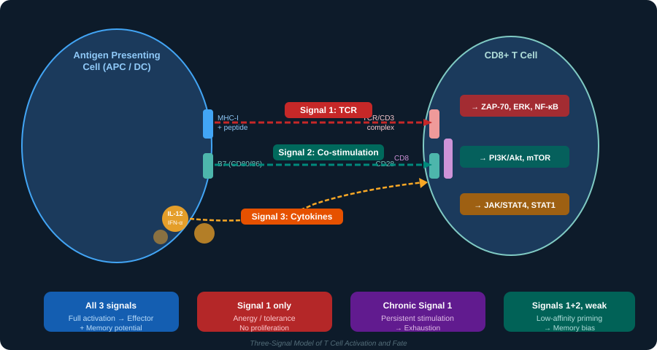
Three Signals of T Cell Activation
Notes:
This slide shows how T cells are activated by the three Signals that we discussed in the homework.
The Antigen Presenting Cell uses MHC to present the antigen to the T cell receptor which is Signal 1.
B7 molecules on the APC engage CD28 on the T cell which is Signal 2.
Cytokines like IL-12 and IL-2 in the environment provide Signal 3.
Depending on which receptor gets engaged on the cell surface each signal will traverse it’s own pathway of proteins which includes various kinases and transcription factors to eventually result in some gene expression.
For Signal 1 alone (antigen recognition without cytokines) the cell recognizes its target but becomes functionally unresponsive.
Signals 1 and 2 together produce both effector and memory differentiation and then adding Signal 3 will strongly bias this toward the effector fate.
Finally, Signals 1 and 2 under severe antigen exposure will result in exhaustion.
EXPLANATION FOR UNDERSTANDING
Why three signals? Because each provides essential, non-redundant information:
Signal 1 alone → anergy (the cell recognises antigen but receives no danger signal)
Signals 1+2 → activation + effector/memory differentiation
Signals 1+2+3 (IL-12) → strong effector commitment; IL-12 is the key 'effector-biasing' cytokine
Signals 1+2 + chronic stimulation → exhaustion via NFAT/TOX
The PI3K→Akt→mTOR axis (Signal 2) is particularly important: mTOR activation phosphorylates and inactivates FOXO1, directly preventing the memory programme. This is why strong co-stimulation can paradoxically reduce memory formation at high doses.

Slide 5
Conditions During Antigen Presentation That Bias Fate
1
2
3
TCR Signal Strength
Co-stimulation (Signal 2)
Cytokine Milieu (Signal 3)
Low affinity → memory bias (FOXO1 active, TCF-1 preserved)
High affinity → effector bias (mTOR active, T-bet↑)
Chronic/persistent → exhaustion (TOX induction, PD-1↑)
Signal strength measured by pMHC dwell time & CD8 co-receptor engagement
CD28:B7 engagement activates PI3K → Akt → mTOR
Strong CD28 → promotes both effector AND memory
Weak/absent co-stim → anergy (NFAT without AP-1)
CTLA-4 competes with CD28 for B7 binding (inhibitory)
IL-12 + IFN-α: strong T-bet induction → effector fate
IL-2: survival signal; promotes effector + early memory
IL-7/IL-15: homeostatic memory maintenance
TGF-β + IL-10: exhaustion-promoting; SMAD signaling
Notes:
Next I wanted to explain what actually determines fate at the molecular level.
The first signal, which is TCR affinity is measured by how long the MHC stays bound to the T cell receptor. Low affinity will keep the regulatory transcription factor FOXO1 active and preserves TCF-1 which biases towards memory cells.
High affinity activates a kinase called mTOR and increases expression of T-bet protein biasing towards effector cells.
And if the signal is chronic and persistent, you get induction TOX and increased expression of PD-1 which biases towards exhaustion.
Something important to note Is that signal duration matters as much as signal strength.
EXPLANATION FOR UNDERSTANDING
The NFAT/AP-1 switch is a key concept: under acute stimulation, NFAT partners with AP-1 (FOS/JUN) to activate effector genes. Under chronic stimulation, AP-1 is lost (suppressive TME signals reduce FOS/JUN), so NFAT acts alone — activating TOX, NR4A, PD-1 instead.
The mTOR/FOXO1 seesaw: strong TCR+CD28 → PI3K → Akt → mTOR → phospho-FOXO1 (cytoplasmic, inactive) → no IL-7R, no TCF-1 → effector fate. Weak signal → FOXO1 stays nuclear → memory fate.
For exam purposes: know the three signals, their receptors, downstream pathways (ZAP-70/ERK, PI3K/Akt/mTOR, JAK/STAT), and how each biases the T-bet vs. FOXO1/TCF-1 balance.

Slide 6
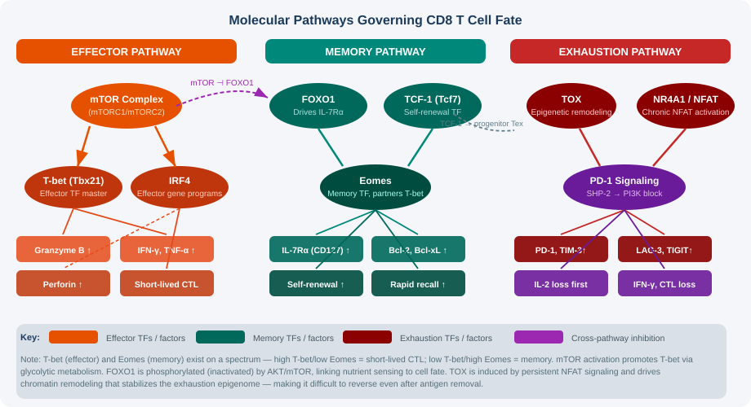
Molecular Pathways: T-bet, FOXO1, TCF-1, TOX
Notes:
So, final time I’ll describe this but just to present the big picture:
Effector Pathway: mTOR complex activates two transcription factors — T-bet (Tbx21), which drives effector gene programs. T-bet directly increases expression of the cytolytic protiens listed here. The result is a short lived CTL or effector cell. Another important thing is if you see the the dashed arrow: mTOR actually phosphorylates and inactivates FOXO1, which represents the switch between effector and memory and how you can sort of only converge on one side.. When mTOR is on, FOXO1 is off, and vice versa.
Memory pathway: FOXO1 drives expression of the CD127 which is listed as IL-7Rα here. TCF-1 which is a self-renewing transcription factor allowing memory cells to last hence maintaining the properties of memory cells. Together they activate Eomes, which is like T-bet’s but for the memory pathway which will produce it’s own molecules to enforce memory cell function. The T-bet/Eomes balance is key: high T-bet + low Eomes = short-lived effector; low T-bet + high Eomes = long-lived memory.
And finally is the exhaustion pathway which I went into depth of earlier. TOX creates feed-forward loop where exhaustion reinforces itself.
"This three-column infographic maps the molecular pathway for each fate separately. Left column — effector: mTOR drives glycolysis, T-bet and IRF4 drive cytotoxic gene expression, Bcl-2 family balance shifts toward pro-apoptotic. Middle column — memory: FOXO1 remains nuclear, TCF-1 drives self-renewal genes, Eomes maintains cytotoxic potential, Bcl-2 is upregulated for survival. Right column — exhaustion: TOX drives chromatin remodelling at PD-1, TIM-3, LAG-3 loci, locking in the dysfunctional state. The cross-pathway inhibition arrows show that these programmes are mutually antagonistic — you can't be fully in two fates at once."
EXPLANATION FOR UNDERSTANDING
Epigenetic lock in exhaustion: TOX recruits HDAC complexes that create a stable chromatin state. This is why exhaustion is hard to reverse — the marks persist even after antigen removal or PD-1 blockade. It is not just a transcriptional switch; it is a permanent chromatin reorganisation.
IRF4 dose-response: at low levels IRF4 promotes memory; at high levels (high TCR signal) it drives terminal effector and eventually exhaustion programmes. This is a classic case of a transcription factor having dose-dependent, qualitatively different effects.
Metabolic-transcriptional coupling: mTOR promotes aerobic glycolysis (Warburg effect) suited to rapid effector expansion. Memory cells shift to oxidative phosphorylation (OXPHOS) and fatty acid oxidation — more efficient for long-term maintenance. Exhausted cells lose mitochondrial fitness entirely.

Slide 7
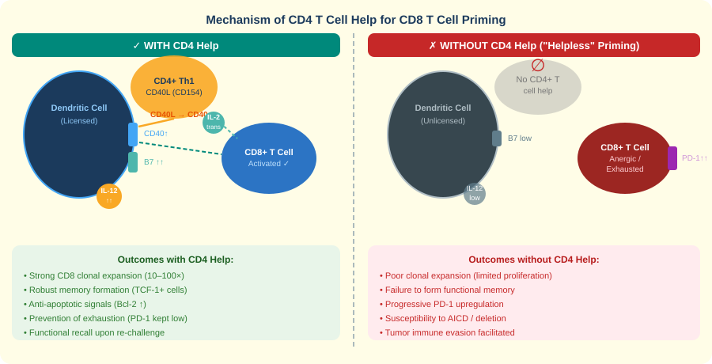
Role of CD4 T Cell Help in CD8 Priming
Notes:
This slide compares what happens WITH versus WITHOUT CD4 help. CD4 help is pretty important during CD8 priming. With CD4 help, dendritic cells become better licensed, meaning they produce cytokines that support CD8 expansion and memory formation. CD4 cells also provide IL-2, which helps CD8 cells proliferate and like basically survive. As a result you’ll have stronger clonal expansion, better memory development, and less exhaustion. Without CD4 help, you get what I think is called helpless priming. Here the dendritic cells aren’t activated too much, you have weaker CD8 responses, and the cells are more likely to become dysfunctional or exhausted. So CD4 cells are actively shaping the priming environment to determines the quality of CD8.
EXPLANATION FOR UNDERSTANDING
This explains why helpless priming is a major problem in cancer. Tumours achieve CD4 help deprivation by two mechanisms: (1) Foxp3+ Tregs dominate the CD4 compartment within the TME, suppressing conventional Th1 responses; (2) many tumours downregulate MHC class II, preventing CD4 priming against tumour antigens.
For exam: the three mechanisms of CD4 help are: DC licensing (CD40L→CD40 → B7↑, IL-12↑), IL-2 provision in trans (drives proliferation, Bcl-2↑, memory precursor formation), and prevention of PD-1/exhaustion by maintaining adequate co-stimulation.
Helpless CD8 T cells show normal primary responses but fail secondary responses — important distinction for vaccine design.

Slide 8
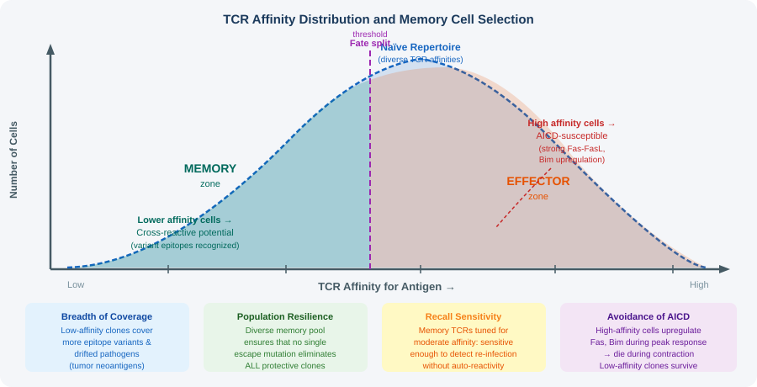
TCR Repertoire, Affinity, and Memory Cell Selection
Notes:
This is one of the most counterintuitive and interesting findings in T cell biology. The bell curve on the left shows a typical distribution of TCR affinities responding to a given antigen. The memory zone — the blue area — is shifted LEFT of the peak response. We find that lower-affinity cells, not the highest-affinity one, are the ones that survive to form memory. Whyis this? There are two reasons: first, high-affinity cells upregulate Bim strongly during activation, making them susceptible to cell. Second, mTOR activation in high-affinity cells will phosphorylate FOXO1, removing its ability to express thing things it needs long-term survival.
EXPLANATION FOR UNDERSTANDING
The Zehn et al. 2009 paper (Nature) is the landmark reference — they used altered peptide ligands of known affinities and tracked which clones ended up in memory. Lower affinity = disproportionate memory contribution.
Four systems advantages of lower-affinity memory:
1. Cross-reactivity: lower affinity TCRs bind a broader range of structurally similar peptides — critical for recognising mutated tumour neoantigens
2. Repertoire breadth: diversity protects against single-epitope escape
3. Avoidance of autoimmunity: highest affinity T cells are closest to self-reactivity thresholds
4. Sustained recall: moderate re-stimulation drives durable responses; very high affinity risks rapid re-exhaustion
For the exam: the key mechanism is mTOR-mediated FOXO1 inactivation in high-affinity cells → loss of CD127/Bcl-2 → death during contraction.

Slide 9
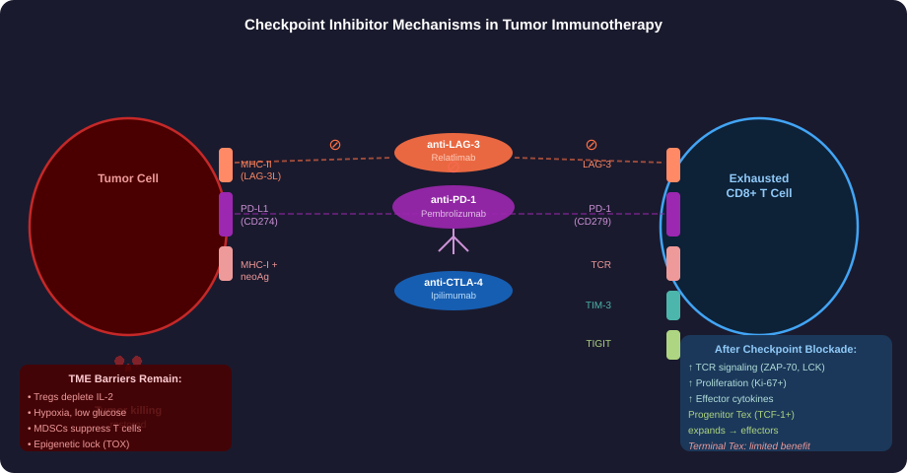
Tumor Immunotherapy — Checkpoint Inhibitor Mechanisms
Notes:
"This slide shows the tumour enviornment with an exhausted T cell on the right and a tumour cell on the left. Multiple inhibitory receptor-ligand pairs are shown. The big idea here is that tumors push CD8 T cells into some exhausted state by activating inhibitors like PD-1 and also um CTLA-4 I think was one. These block those signals so T cells can regain some of their ability to attack tumor cells. Anti-PD-1 mainly give strength exhausted T cells already in the tumor, while anti-CTLA-4 helps earlier during T-cell activation and can reduce suppression by regulatory T cells. Overall, therapy doesn’t create new T cells, butit mainly slows existing anti-tumor T cells so they can function again.
EXPLANATION FOR UNDERSTANDING
Adaptive immune resistance is a critical concept: tumour cells sense IFN-gamma (produced by functional T cells) and upregulate PD-L1 in response. This means the immune response to the tumour directly induces the tumour's ability to suppress that response — a self-defeating feedback loop.
Why does anti-PD-1 work in some patients but not others? The progenitor Tex pool. Patients with few TCF-1+ progenitor exhausted cells at baseline respond poorly — they only have terminal exhausted cells that don't proliferate after PD-1 blockade.
Drug names to know: pembrolizumab (anti-PD-1, Keytruda), nivolumab (anti-PD-1, Opdivo), atezolizumab (anti-PD-L1), ipilimumab (anti-CTLA-4, Yervoy), relatlimab (anti-LAG-3, combined with nivolumab = Opdualag).

Slide 10
T Cell Exhaustion — Drivers, Stages, and Therapeutic Targets
STAGES OF EXHAUSTION
THERAPEUTIC TARGETS
Effector-like
Early, partial function
PD-1lo, TCF-1+, proliferative
still responds to stimulation
anti-PD-1 / anti-PD-L1
Pembrolizumab, Nivolumab, Atezolizumab
Blocks SHP-2 activation; restores TCR signaling in progenitor Tex. Most effective at progenitor stage.
Progenitor
Exhausted
TCF-1+, PD-1int, TOXlo
Self-renewing subset
Responds to anti-PD-1 therapy
anti-CTLA-4
Ipilimumab, Tremelimumab
Acts at priming phase. Depletes Tregs in TME via ADCC. Synergizes with anti-PD-1 in combination therapy.
Transitory
Ki-67+, expanding
Generated from progenitors
after checkpoint blockade
anti-LAG-3
Relatlimab (+ Nivolumab = Opdualag)
LAG-3 binds MHC-II; blockade enhances TCR signaling. Approved for melanoma in combination with PD-1.
Terminal
Exhausted
TIM-3+, TOXhi, CX3CR1-
No self-renewal, AICD prone
Poor response to therapy
anti-TIM-3 / anti-TIGIT
Sabatolimab, Tiragolumab (trials)
Target terminally exhausted cells. In trials alone and in combination. TIGIT competes with CD226 for CD155.
Notes:
Nearing the end of the presentation now this slide maps out exhaustion. On the left you’ll have the four stages: Effector-like (early, partial function, still proliferative), Progenitor, Transitory, and Terminal. All exhausted T cells are the same. Early ones have the ability to grow and respond to treatment while later ones are much more dysfunctional and harder to rescue. Checkpoint therapies mainly work by targeting those earlier-stage exhausted cells and boosting their activity. So timing and the state of the T cells really matter for how well treatment works.
EXPLANATION FOR UNDERSTANDING
The stage of exhaustion matters for prognosis and therapy selection:
- Progenitor Tex (TCF-1+): responds to anti-PD-1 → expands → transitory effector → tumour control
- Terminal Tex (TIM-3+ TOXhi): does NOT respond to anti-PD-1; epigenetically locked
- Therefore: measuring TCF-1 expression in tumour biopsies predicts anti-PD-1 response
Why combine anti-PD-1 + anti-CTLA-4? They have distinct mechanisms:
- Anti-PD-1: removes brake in TME, primarily affects progenitor Tex
- Anti-CTLA-4: amplifies priming in lymph node + depletes Tregs in TME → more CD4 help → better CD8 priming
Together they address different nodes of suppression — synergy rather than just addition.
LAG-3 approval context: Opdualag (relatlimab + nivolumab) approved FDA 2022 for unresectable melanoma. First new checkpoint combination in >10 years.

Slide 11
Key Takeaways
A
Three fates arise after antigen exposure: Effectors kill acutely; Memory cells self-renew for durable protection; Exhausted cells are epigenetically locked into dysfunction — but progenitor subsets remain targetable.
B
Fate is determined by TCR signal strength, co-stimulation (CD28:B7), and cytokine context (IL-12 vs. TGF-β). Key TFs: T-bet (effector), FOXO1/TCF-1/Eomes (memory), TOX/NR4A1 (exhaustion). mTOR vs. FOXO1 balance is central.
C
CD4 T cell help licenses DCs (CD40L→CD40), provides IL-2 in trans, and prevents exhaustion. Without it, CD8 cells undergo helpless priming. Vaccines must include MHC-II epitopes and Th1-promoting adjuvants.
D
Lower-affinity TCR clones survive contraction to form memory (avoiding AICD via weaker Fas/Bim signals). This preserves breadth and cross-reactivity — critical for variant pathogens and mutated tumor neoantigens.
"The identity of a T cell is written not just in its genes, but in the history of its encounters with antigen."
Notes:
I guess I can summarize the main points/questions answered by this presentation. First, the three fates – Killer Effectors, Memory, Exhausted T Cells — are distinct epigenetic states, not just points on a spectrum. Second — Fate is determined by signal strength, stimulation, and cytokine context especially how I mentioned the trade off of T-bet vs. FOXO1 or TCF-1. Third — CD4 help is not optional: dendredic cell licensing, IL-2, and prevention of exhaustion are all CD4-dependent. Without it, CD8 responses are inferior and prone exhaustion. Finally, Memory clones are lower-affinity because high-affinity cells die by Activation-induced cell death. For cancer: this means the memory pool that can surveil tumours and respond to checkpoint therapy is built from moderate-affinity clones."
EXPLANATION FOR UNDERSTANDING
The closing quote — 'The identity of a T cell is written not just in its genes, but in the history of its encounters with antigen' — captures the key principle: T cell fate is epigenetically imprinted by the signals it receives. Transcription factors write the immediate programme; chromatin remodelling makes it permanent.
Integration for the exam:
- Know the transcription factors: T-bet (effector), FOXO1/TCF-1 (memory), TOX/NR4A (exhaustion)
- Know the upstream signals: TCR → ZAP-70 → ERK/NFAT; CD28 → PI3K → Akt → mTOR; cytokines → JAK → STAT
- Know the mTOR/FOXO1 seesaw: strong mTOR → FOXO1 phospho → cytoplasm → no memory programme
- Know CD4 help mechanisms: CD40L→CD40 licensing + IL-2 in trans + B7 maintenance
- Know why lower-affinity = memory: AICD avoidance (less Fas/Bim), FOXO1 preservation (less mTOR), cross-reactivity advantage

